Slide 1

XN PROJECT draft: eda presentation(GROUP)
College of Professional Studies, Northeastern University
Sean McLean
Paula Andrea Romero Melo
Gauri Udaysing Shinde
Ted Smith

Slide 2
INTRODUCTION
Introduction of Project
Executive Summary
Business Problem
Analytics / Visuals
Recommendations & Findings
Future Research

Slide 3
Executive summary
Objective: Identify areas of interest for Yeoman Technology Group.
Dataset Analysis: Each member found patterns providing insights for potential deliverables.
Focus Areas: Market Share Clicks and Search Query.

Slide 4
Business problem
Challenge: Help pre-Internet brands improve digital sales without disrupting existing wholesale and retail channels.
Strategy: Utilize Amazon data to enhance client understanding of pricing, advertising, and merchandising programs.
Goal: Create scalable Brand Influence and Ad Spend Optimization models to improve advertising strategies and brand positioning on Amazon.

Slide 5
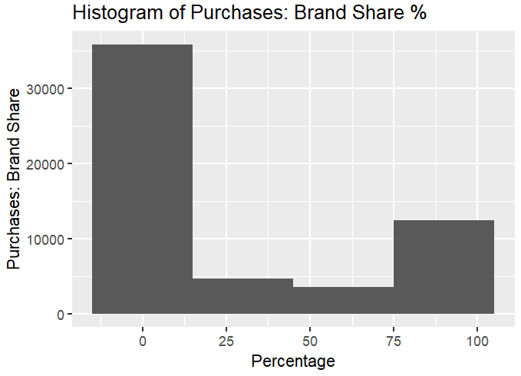
Analytics/visuals
Key Insights from Brand Share Histogram
Market Dominance: Few brands dominate with high percentages.
Barriers to Entry: High prevalence of 0% indicates strong brand loyalty and high entry costs.
Competition Intensity: Significant gap between 0% and dominant brands.
Market Maturity: Concentration at extremes indicates a mature market.

Slide 6
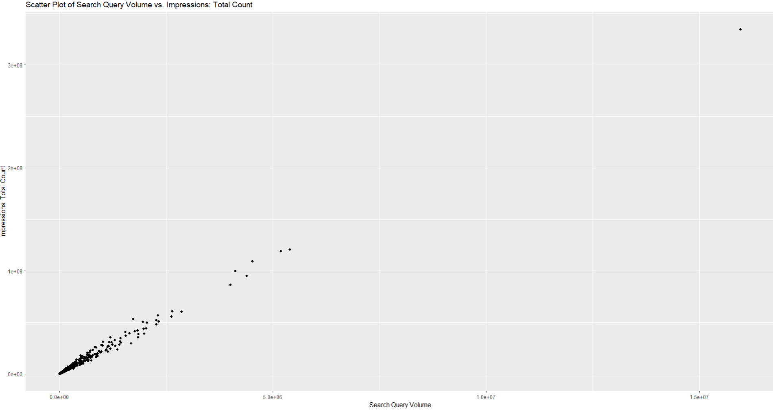

Search query volume Vs. impressions: total count
Observation: Linear relationship between search query volume and ad impressions.
Implication: Focusing advertising on high search query areas can increase ad visibility.

Slide 7
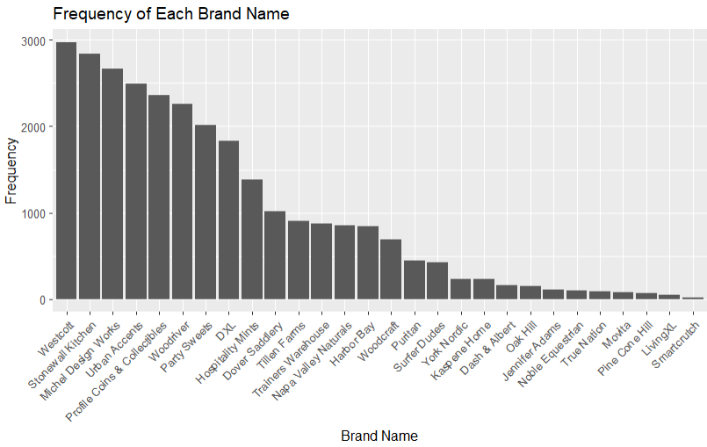
BRANDS FREQUENCY
Brand Popularity.
Strong market presence in the top 5 of brands.
Lower frequencies may be niche players or newer entrants.
No evidence of outliers.

Slide 8
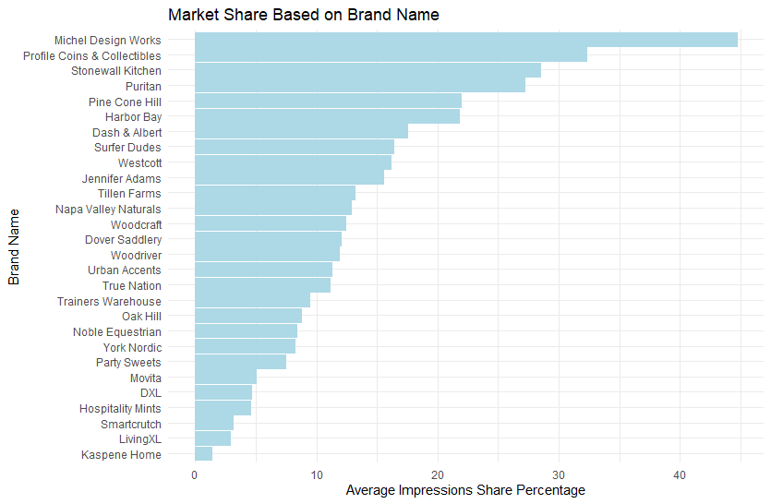
MARKET SHARE BY COMPANY
There is a definite wide range of market share for each of the companies/brands.
Smaller market share has potential for greater percentage increase in sales and or profit.
Are the smaller brands willing to put up the effort and capital to try changing?

Slide 9
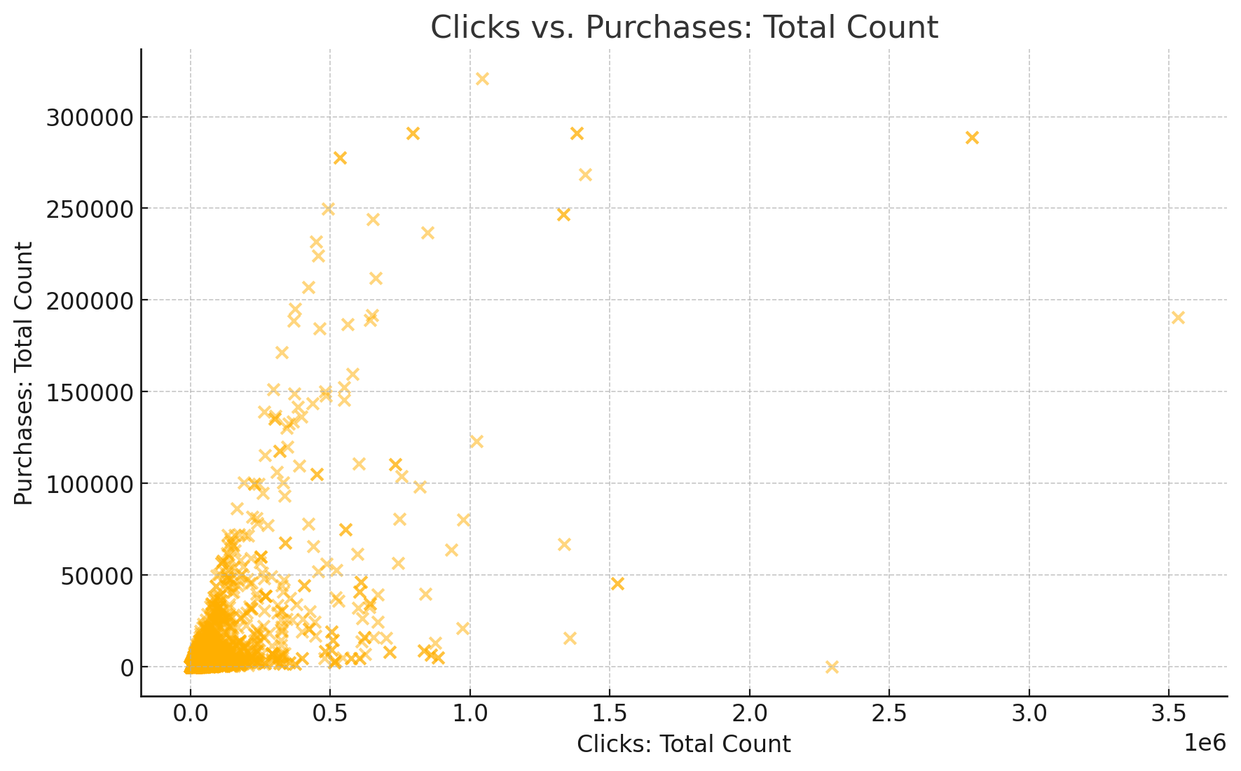

Clicks vs. Purchases: Total Count
Data Concentration: Most queries have low clicks and purchases, indicating low engagement and conversion.
Outliers: Some queries have high clicks but low purchases.
Recommendation: Optimize high-click, low-purchase queries to improve performance.

Slide 10
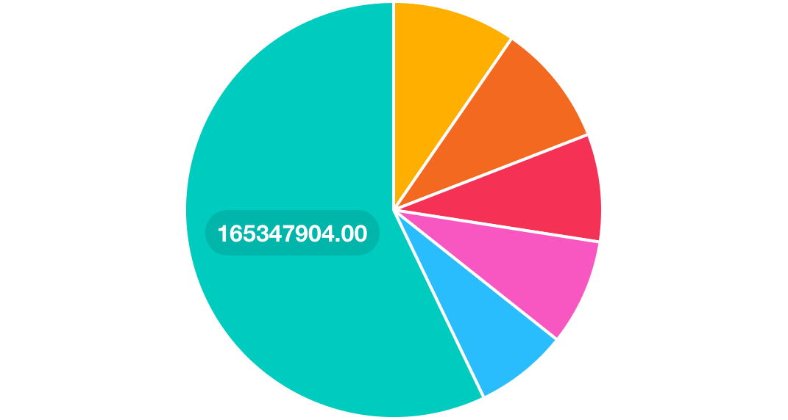
Simplified Distribution of Clicks by Brand
Dash & Albert: Largest share of clicks, high user interest.
Kaspene Home: Substantial portion of clicks, reflecting strong brand visibility.
Urban Accents: Significant share, suggesting effective query performance.
PineCone Hill: Moderate clicks, indicating steady user interest.
Stonewall Kitchen: Noticeable portion of clicks, showing competitive engagement.
Others: Aggregated smaller brands, highlighting dominance of top brands.

Slide 11
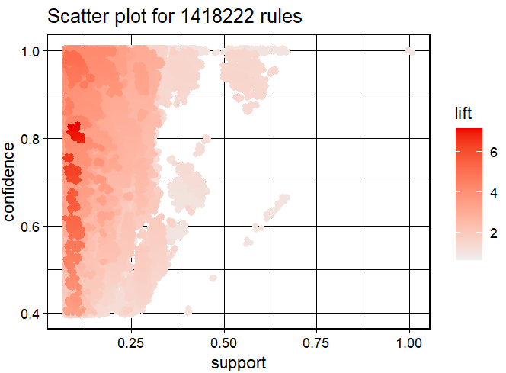
Association mining of dataset
Understanding Key Metrics:
Support: Confidence:, and Lift.
Interpreting the Scatter Plot:
Reliable itemsets with high support and confidence, potential cross-selling opportunities with high lift.
Implications for Amazon:
Identifying common combinations, targeted marketing, enhancing recommendation systems.

Slide 12
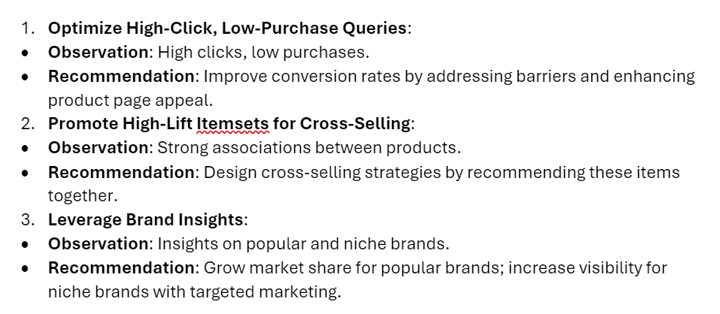
Recommendations and findings

Slide 13

Future research
Continued refinement of analysis to provide specific guidance.
Exploring temporal trends to understand seasonal trends and long-term shifts.
Advanced predictive modeling to forecast future sales trends and customer preferences.

